Slide 1
Unknown words
a rocket engineer – načrtovalec raket
a pioneer of astronautics – pionir astronavtike; kdor se je med prvimi ukvarjal s poleti v vesolje
a geostationary orbit – geostacionarna orbita je krožnica, ki teče 35.900 km nad ekvatorjem
a gravity force – težnost
to release – izdati

Slide 2
Clip from film at Google Video
2001: A Space Odyssey
Some pictures of space station shown in Kubrick film
http://www.imdb.com/title/tt0062622/

Slide 3
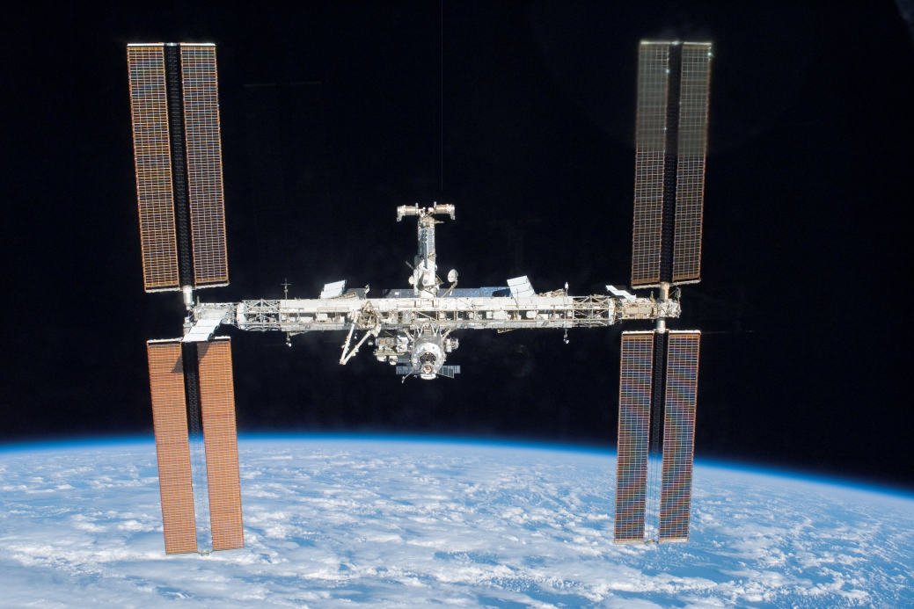
I will talk about the first man, who made
plans for USING SATELITES,
and invented many other things.

Slide 4
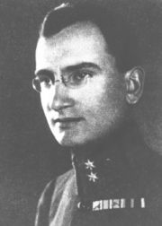
Herman Potočnik Noordung
Potočnik was a Slovene rocket engineer and pioneer of astronautics, born in Pula in December 1892 and died in Vienna in August 1929.

Slide 5
Chapter 1:
BIOGRAPHY

Slide 6
FAMILY
father from Slovenj Gradec, doctor in army
mother from Vitanje, daughter of winer and Vitanje mayor Jožef Kokošinek
2 brothers, both army officers and sister

Slide 7
SCHOOL
primary school in Maribor
military secondary school in Moravia
uncle Henrich enabled his study on tehnical military academy near Vienna
specialization: building of railways and bridges

Slide 8
WAR YEARS
Potočnik served in several countries
important for Soča battelfields
he got tuberculosis during war, so he retired from the army in year 1919
after war he got high amry rank compared to small pension

Slide 9
ENGINEERING
study of electrical engineering on the University of Technology in Vienna
during study he became very intrested in rocketry
after study he started writing book about space traveling
he didn't find a job or marry, but lived with his brother
because of illnes he died at only 36 years of age

Slide 10

Chapter 2:
POTOČNIK'S FAMOUS BOOK
German: Das Problem der Befahrung
des Weltraums
English: The Problem of Space Travel
Slovene: Problem vožnje po vesolju

Slide 11
FACTS ABOUT THE BOOK
published in the end of 1928 in Berlin, Germany
plan for space station and traveling to it
calculated geostationary orbit for all satellites
~ 35 900 000 m above sea level
with many indeas in book Potočnik became pioneer of astronautics

Slide 12
FACTS ABOUT THE BOOK II
Book introduced the full concept of geostationary satellites.
Potočnik visions of satellites were made in a reality in 1962 with the launch of Telstar.
Encyclopedia Larousse says »Potočnik's book was like a textbook for making earlier space vehicles.«
(von Braun about making V1 [fau eins] and V2 rocket)

Slide 13
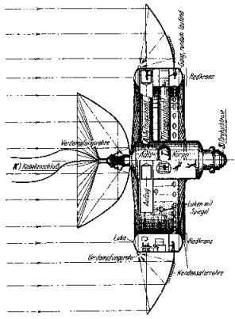
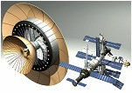
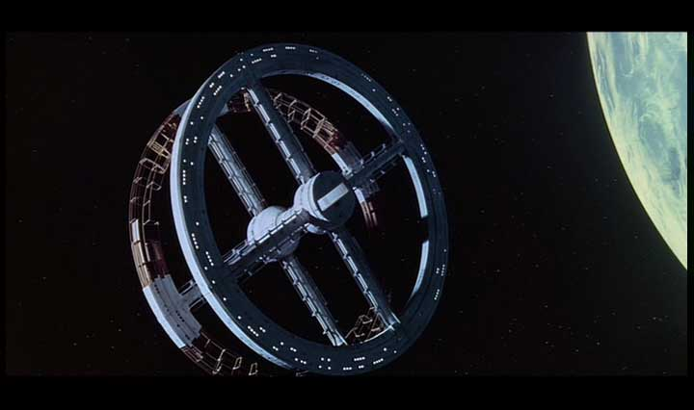
SPACE SATION
Simon Zajc ilustration of
Potočnik's station
Station Mir
Ilustration from book
(site 157)
Stanley Kubrick's film 2001: A Space Odyssey.

Slide 14
SPACE STATION in details
From 3 parts:
  Rotating living wheel with diameter of 50 meters, which creates centrifugal force, similar to gravity. It will include private cabins, laboratories, workrooms, a kitchen and a bathroom.
  2 large mirrors, which reflect sun'a radiation, and this boils water in heat pipes.
  Turbines on water vapour will driving 3 generators, which will produce electricity
  Good for the time, but now we have solar cells

Slide 15
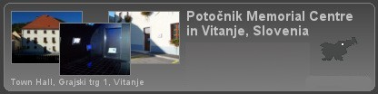
Interesting:
The meaning of his pseudonym Noordung is still a mystery, but some people suggest that he used it to show the problems of chaos (German: keine ordnung; Slovene: nered). If the initial "N" realy means negation, the name would mean "without order".
A proposal was made in the late 1990s to name the International Space Station after him, but was not taken up.
There is a Herman Potočnik memorial centre in Vitanje.
There is Potočnik street
in Ljubljana and Graz.
Spletna stran:
http://www.noordung.info/

Slide 16
Answer questions:
Who was Herman Potočnik and where was born?
Why is he so important?
What is title of Potočnik's book and what is it about?
Where is Potočnik memorial centre?
Did idea for naming ISS after Potočnik succeed?

Slide 17
Questions?
...
...

Slide 18
Sources
http://noordung.vesolje.net/
http://en.wikipedia.org/wiki/Herman_Potočnik
Herman Potočnik: Problem vožnje po vesolju

Slide 19

THANKS FOR VIEWING!
smihael, author of
the text and presentation

